Slide 1
Tribal Caucus
January 7, 2021
Office of Public Instruction Staff
Lona Running Wolf, Director of American Indian Student Achievement
Donnie Wetzel, Tribal, Family and Community Liaison
Julie Murgel, Senior Manager for Department of School Innovation and Improvement

Slide 2
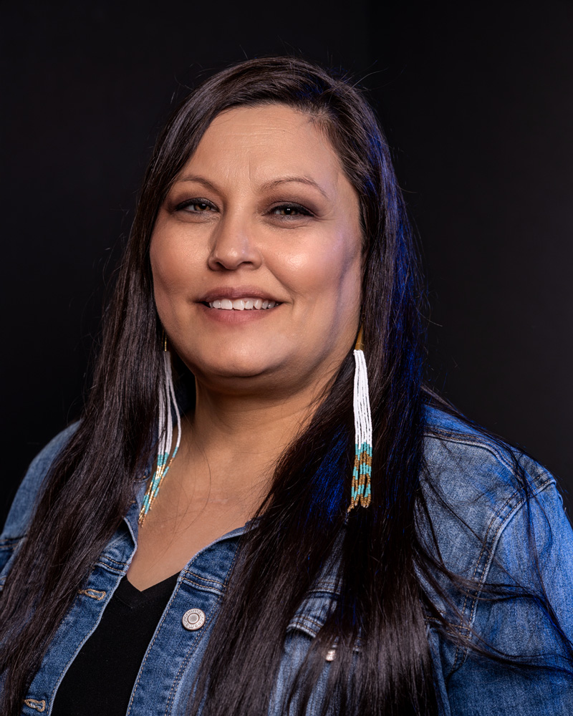

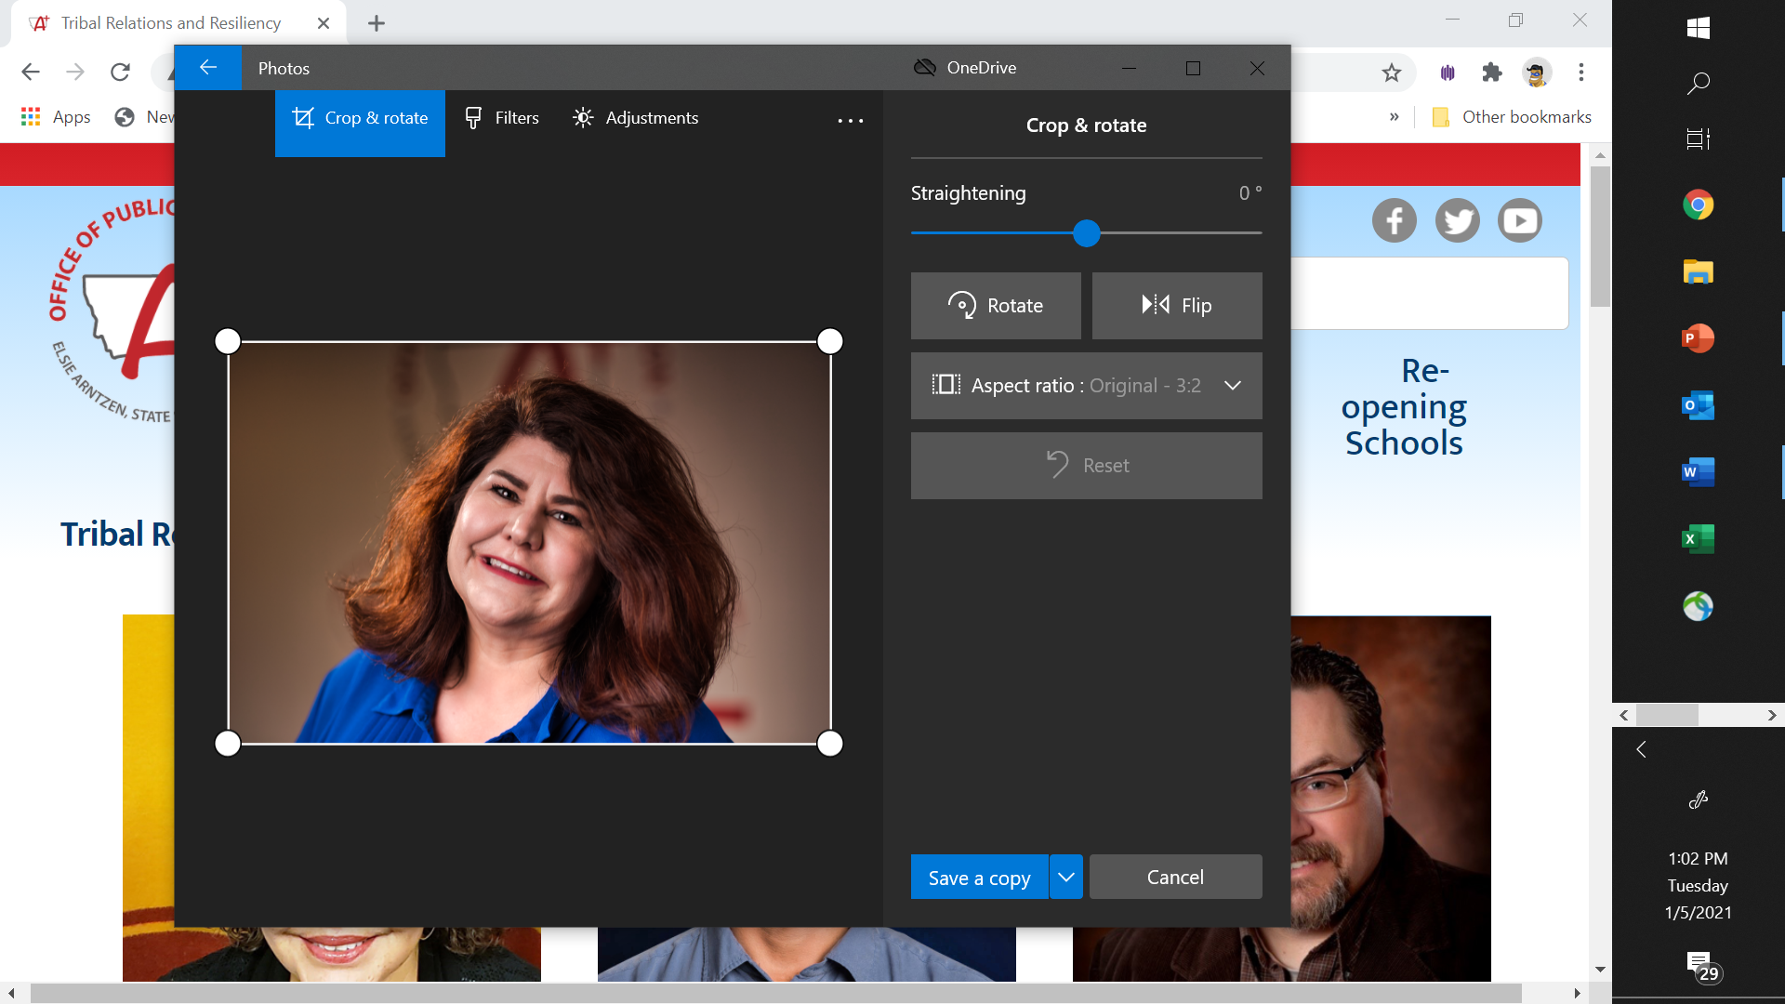
OPI Staff
LONA RUNNING WOLF, DIRECTOR OF AMERICAN INDIAN STUDENT ACHIEVEMENT
406.444.3013
Lona.RunningWolf@mt.gov
DONNIE WETZEL, TRIBAL, FAMILY, AND COMMUNITY LIAISON
406.444.4527
DWetzel2@mt.gov
JULIE MURGEL, SENIOR MANAGER FOR DEPARTMENT OF SCHOOL INNOVATION AND IMPROVEMENT
406.444.3172
Julie.Murgel@mt.gov

Slide 3
Agenda
Welcome and Introductions (5 min)
Review of American Indian Student Data (15min) Lona
  American Indian Students Achievement Gap Report
  Financial Analysis of AI Gap Funding
  Closing AI Achievement Gaps
Tribal Caucus Discussion (15 min) Donnie and Lona
  Questions
  Share-out
Follow-up Items and Setting the stage for next week (5 min)

Slide 4
Focus: American Indian Student Achievement
Data Review from last Introduction
American Indian Student Achievement Gap Report: The OPI prepared this report to track the American Indian achievement gap and provide data on the Montana American Indian student population.
School District Financial Analysis of AI Gap Funding: This report was prepared to analysis how schools districts are using the American Indian Achievement Gap Funding allocated through MCA 20-9-330.
Additional Data Review
3. Student Achievement: Closing Opportunity Gaps and Fulfilling ESSA’s Equity
Promise: Which Montana schools achieved student results for American Indian
students higher than the state sub-group average on the most recent ELA and Math
Statewide Assessments?

Slide 5
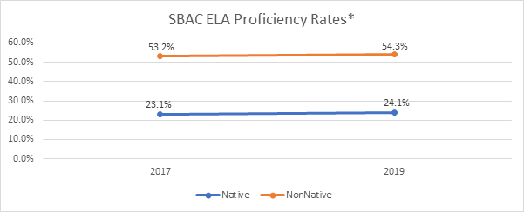
American Indian Student Achievement Gap Report

Slide 6
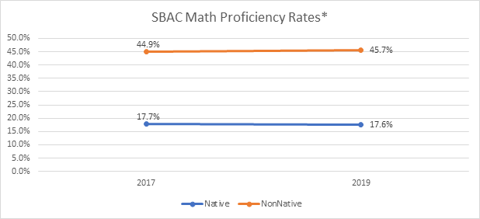
American Indian Student Achievement Gap Report

Slide 7
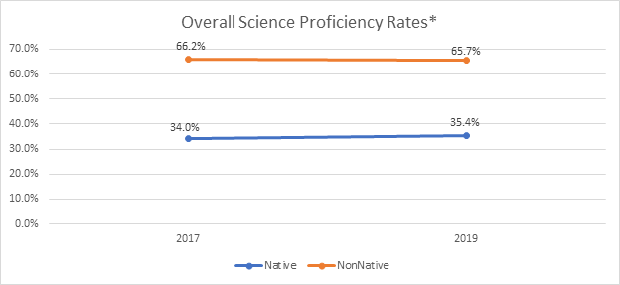
American Indian Student Achievement Gap Report

Slide 8
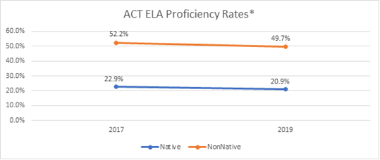
American Indian Student Achievement Gap Report

Slide 9
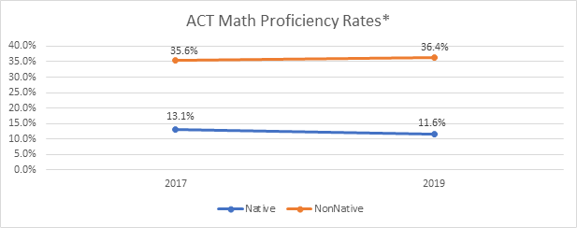
American Indian Student Achievement Gap Report

Slide 10
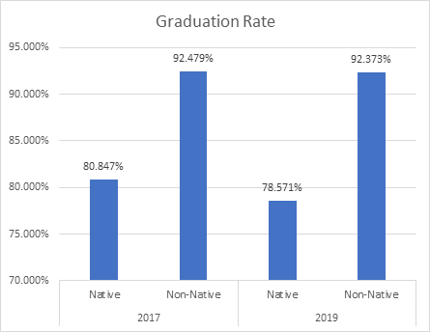
American Indian Student Achievement Gap Report

Slide 11
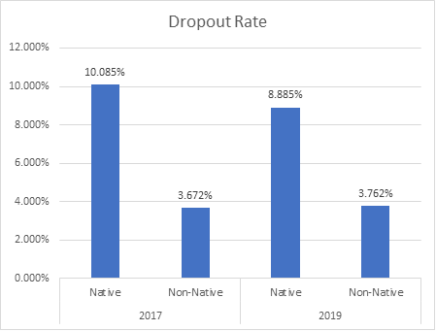
American Indian Student Achievement Gap Report

Slide 12
School District Financial Analysis of AI Gap Funding
29% of responses were clearly qualified AISA expenditures.
Less than 23% of respondents answered all three portions of the question, and that some schools seemed to be reporting expenditures that would qualify as IEFA expenditures rather than AISA expenditures.
42% of schools indicated that AISA funds are being spent on activities more aligned with the intention of IEFA funds.

Slide 13
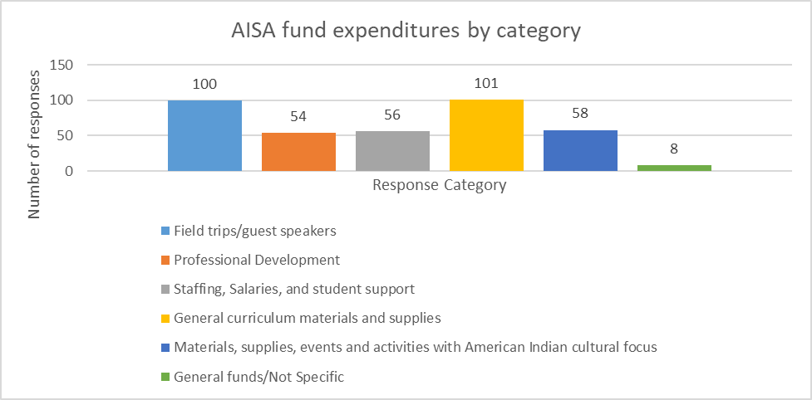
School District Financial Analysis of AI Gap Funding
Notes:
Overall, it appears that 42 percent of schools indicated that AISA funds are being spent on activities more aligned with the intention of IEFA funds, such as field trips and cultural programming, cultural education materials, and activities. Only 29 percent of schools responded that AISA funds were going to support American Indian student achievement efforts through professional development, direct student support, and staffing. Additionally, 27 percent of schools reported the funds being used for general curriculum materials and supplies to benefit all students.

Slide 14
Student Achievement: Closing Opportunity Gaps and Fulfilling ESSA’s Equity Promise
Which Montana schools achieved student results for sub-groups higher than the state sub-group average on the most recent ELA and Math Statewide Assessments?
In the charts below are 4 elementary and secondary examples for American Indian students. The data below follows the OPI’s Student Records Confidentiality Policy, which prohibits the OPI from disclosing data from student groups that are 5 or fewer in number or would otherwise reveal the identity of an individual student. Additionally, overall state-assessments results from 2018-19 are provided as a reference point to use when analyzing the data within the examples.
2018-19 Montana Statewide Assessments
SBAC Proficiency Levels (3rd to 8th grade) ACT Test Scores: (11th grade test takers)
Percent Proficient or Advanced on ELA: 50% Average Composite Score: 19.61
Percent Proficient or Advanced on Math: 41.9% Average ELA Score: 18.40
Average Math Score: 19.62

Slide 15
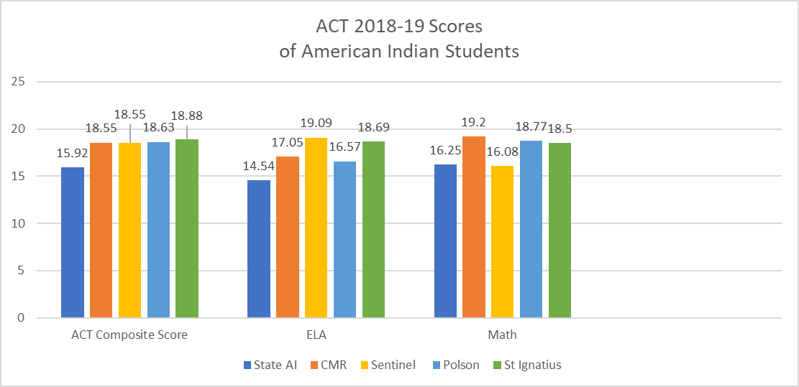
Student Achievement: Closing Opportunity Gaps and Fulfilling ESSA’s Equity Promise

Slide 16
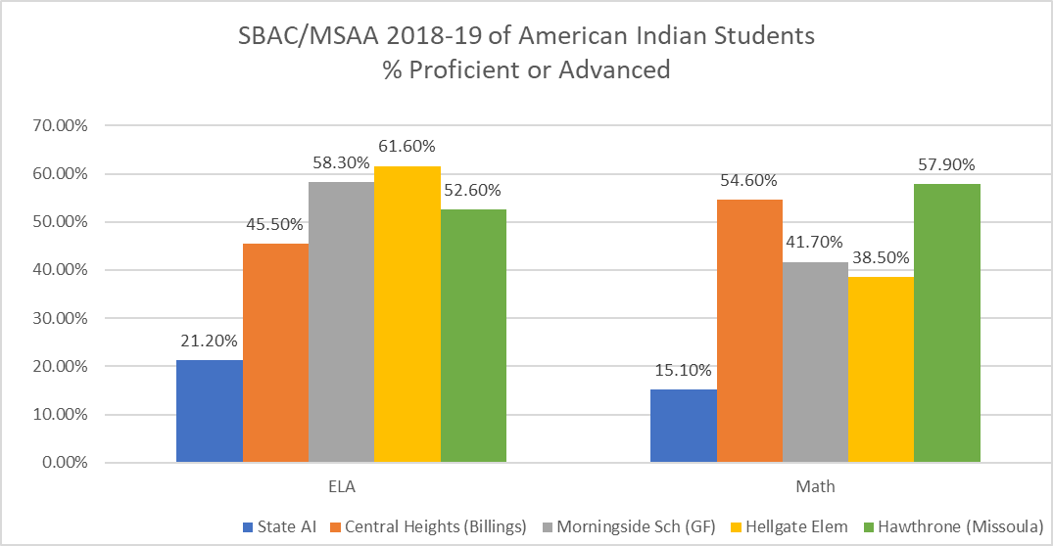
Student Achievement: Closing Opportunity Gaps and Fulfilling ESSA’s Equity Promise

Slide 17
Discussion
Questions
Share-outs

Slide 18
Up next week
Preliminary Results from the American Indian Student Achievement Action Research Plan 2020-2021:
The purpose of this research study was to gather insight from all stakeholders that play a role in American Indian education, to identify factors that contribute to the American Indian student achievement gap.
Notes:
Identify what strategies, programs, or practices schools are using to close gaps in opportunity and outcomes.
Document and share-out school improvement efforts that address sources of inequity and support the success of all students.
Provide resources to support policymakers, district and school leaders, educators, and community members to support continuous school improvement.

